Slide 1
Cubs Christmas Quiz
https://www.facebook.com/groups/50thCambridgeCubs
http://www.50thcambridgescouts.org/cubs

Slide 2
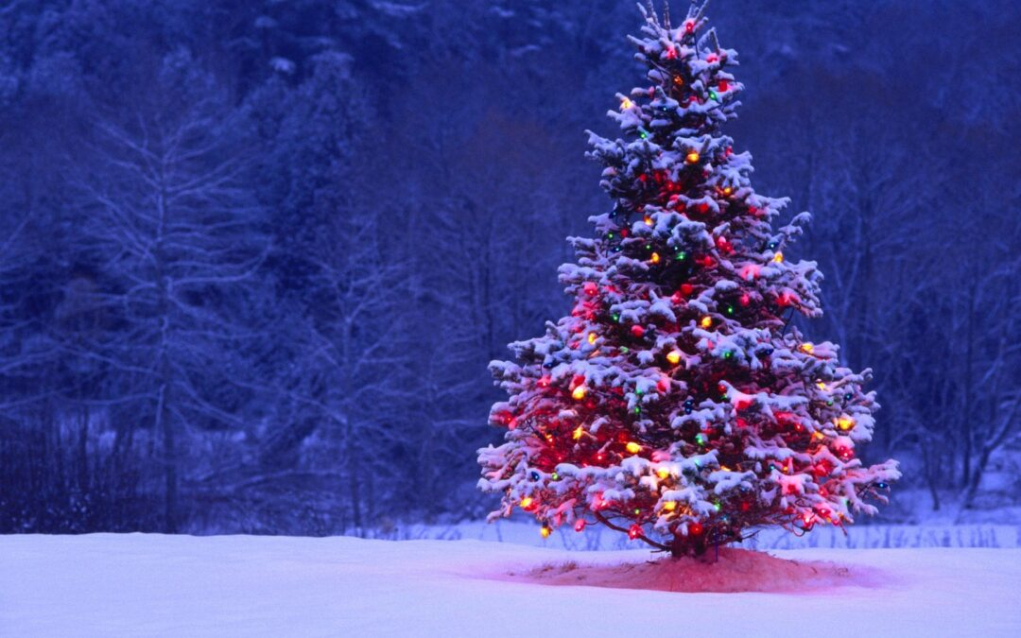
Round Specialist Subject
1 Christmas Movies
2 Bionic Eye
3 Christmas Trivia
4 Festive Food
5 Mystery Objects
6 Name That Tune!

Slide 3
Round 1 - Christmas Movies

Slide 4
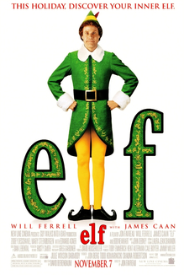
In the movie elf, what is our hero’s name?
A - Billy
B - Bob
C - Buddy
D - Wally

Slide 5
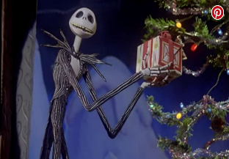
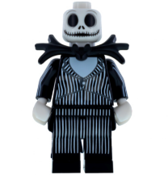
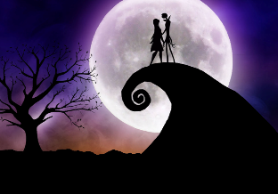
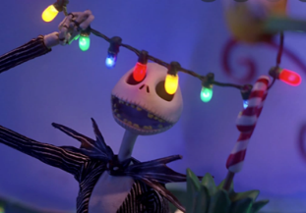
The Nightmare Before Christmas
Before he comes to Christmas Town, where is Jack Skellington the King?
A - Valentown
C - Brightville
B - Halloween Town
D - Legoland

Slide 6
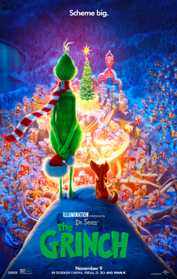
Who created the character ‘The GRINCH’ ?
A - Dr Seuss
B - Dr Spock
C - Dr Seligman
D - Dr Scholl

Slide 7
Why does this boy look so worried?
A - He forgot to post his letter to Santa Claus
C - He missed the Cubs’ Christmas Zoom Quiz 2021
D - He’s been left Home Alone
B - He forgot to buy a Christmas present for Bob

Slide 8
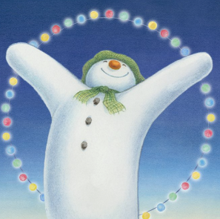
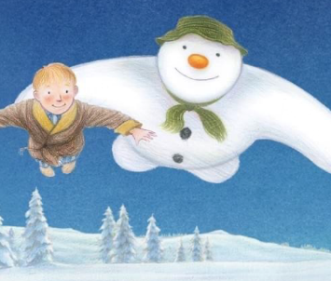
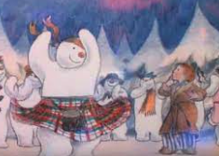
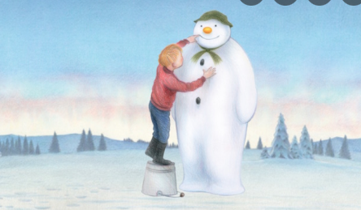
In The Snowman, where do they go for their Christmas Party?
B - The North Pole
A - London
D - Scotland
C - Peru

Slide 9
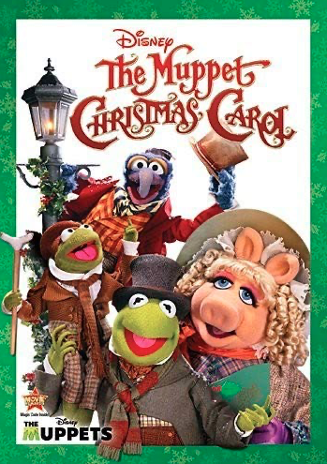
In Christmas Carol, who are the first spirits to visit Scrooge, and how did they know one another?
A - McGrumpy & Grumpface,
old teachers
C - Marley & Marley, business partners
B - Rishi and Boris,
dog walkers
D - Martin Cooper & Ben Bradshaw,
cub leaders

Slide 10
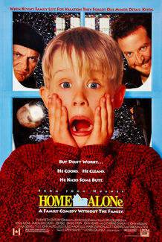
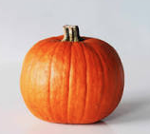
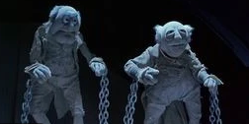
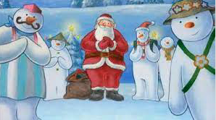
How well did you do?
C - I’m Buddy!
A - Dr Seuss
D
B - Halloween Town
C - Marley & Marley,
business partners
B - The North Pole

Slide 11
Round 2 – Bionic Eye

Slide 12
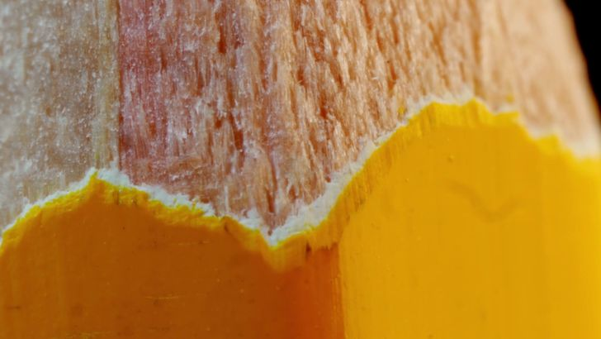

Slide 13
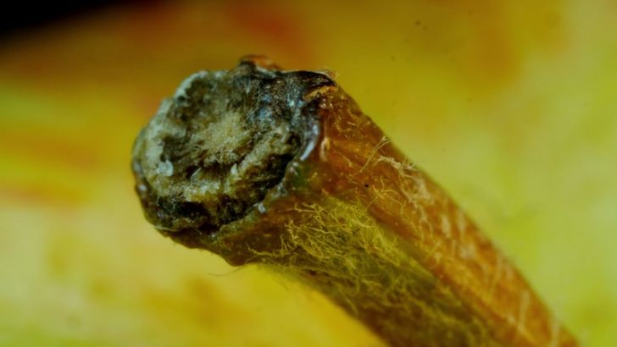

Slide 15
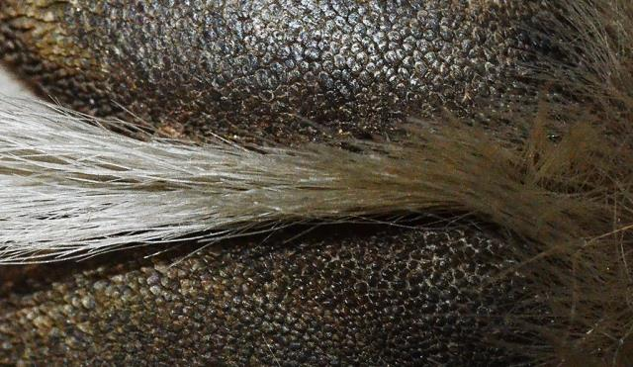

Slide 16
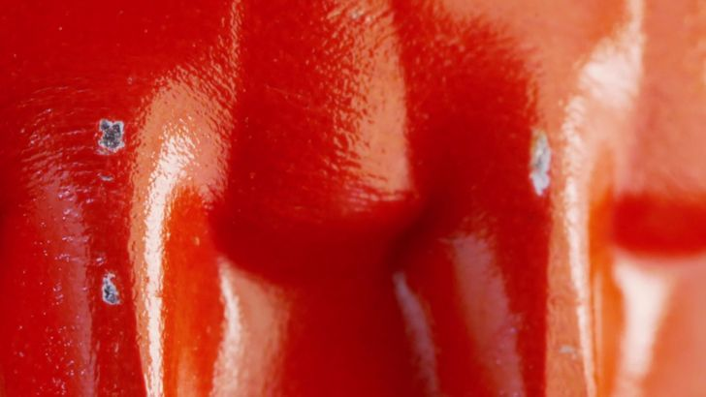

Slide 17
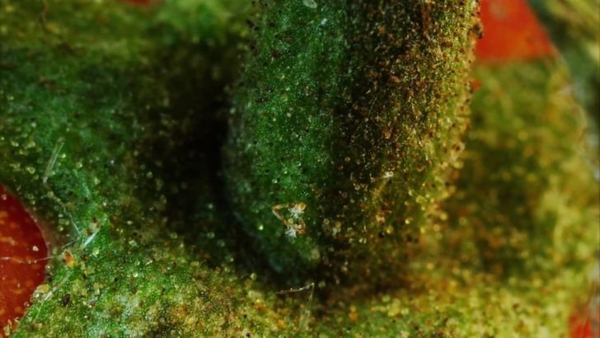

Slide 18
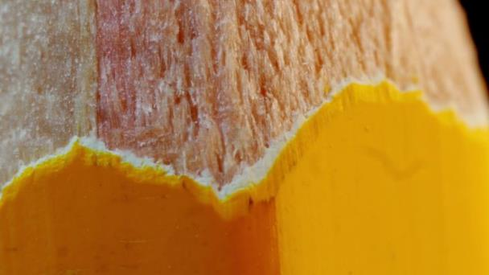

Slide 19
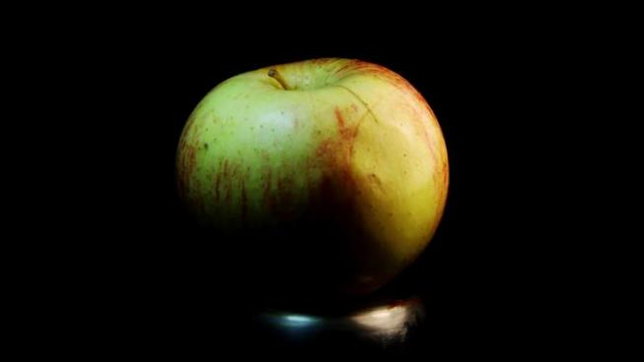

Slide 20
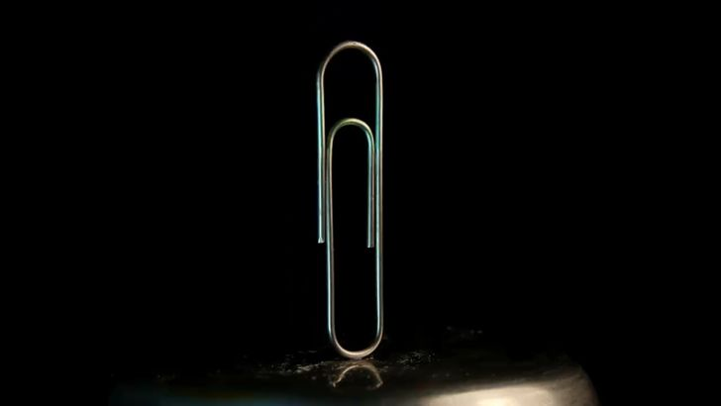

Slide 21
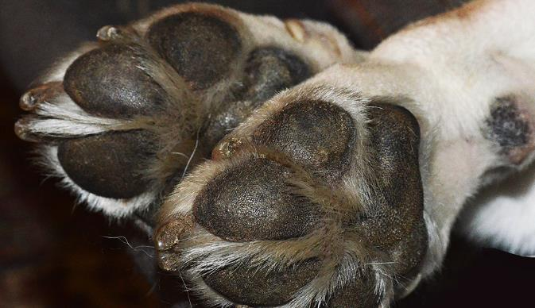

Slide 22
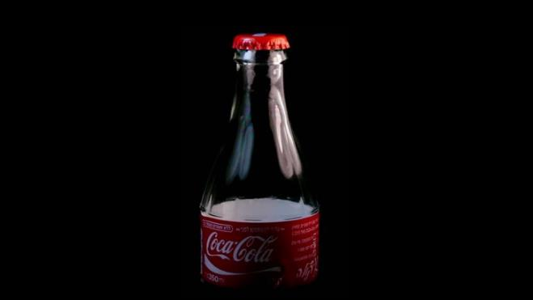

Slide 23
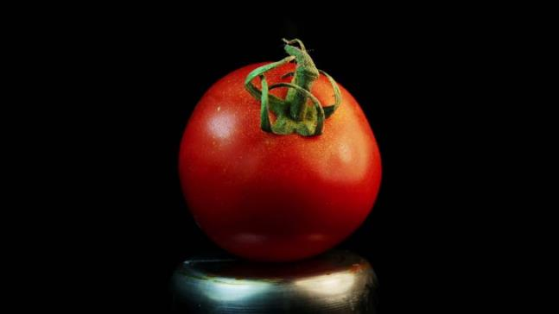

Slide 24
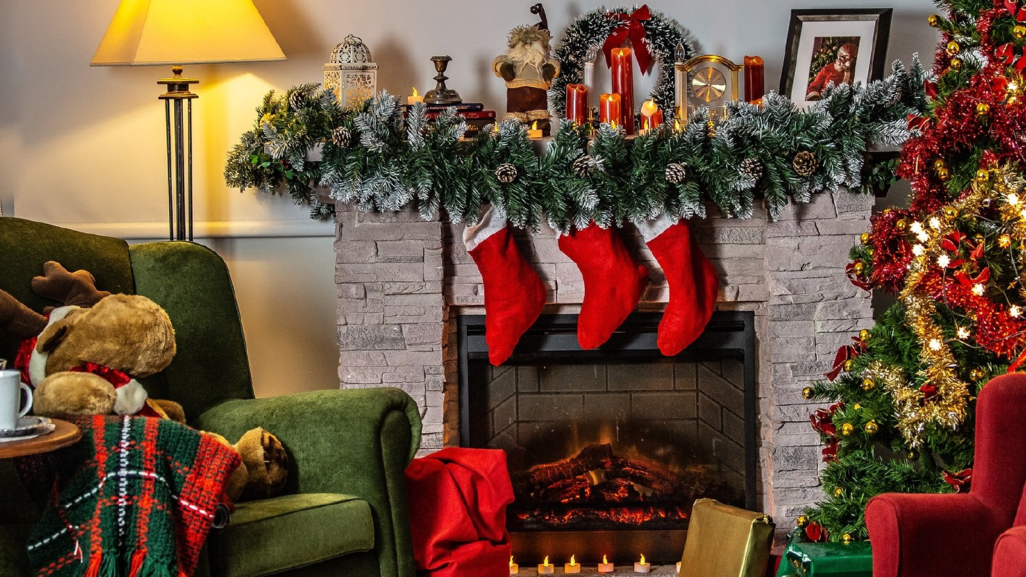
Round 3 – Christmas Trivia

Slide 25
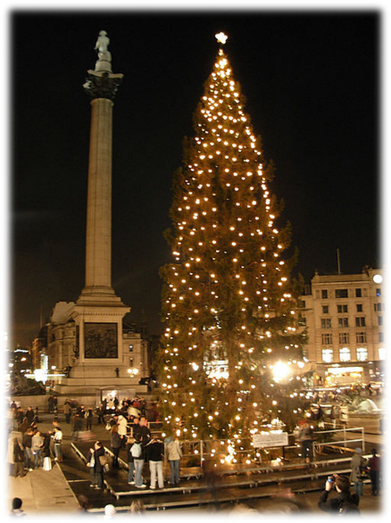
Every year a particular country gives London a Christmas tree. Which country is it?
Norway
Germany
Papua New Guinea
Iceland

Slide 26
On the first day of Christmas,
My true love sent to me,
A ….. in a pear tree
A) Plum Pudding
B) Christmas Cracker
C) Blackbird
D) Partridge

Slide 27
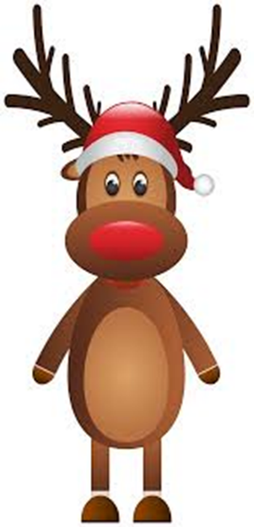
Which of the following is not one of Father Christmas’ reindeer?
Dasher
Blitzen
Venus
Comet

Slide 28
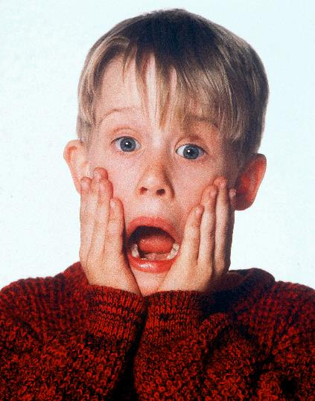
In what film is 8 year old Kevin accidently left behind when his family go on holiday?
Home Alone
Elf
Sant Claus The Movie
It’s A Wonderful Life

Slide 29
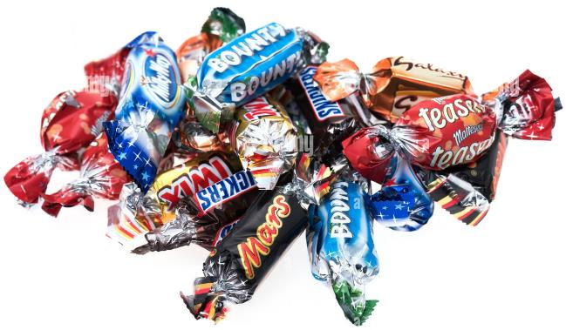
What word meaning ‘Special, enjoyable events’ is also a tub of chocolates?
Parties
Celebrations
Festivities
Jubilees

Slide 30
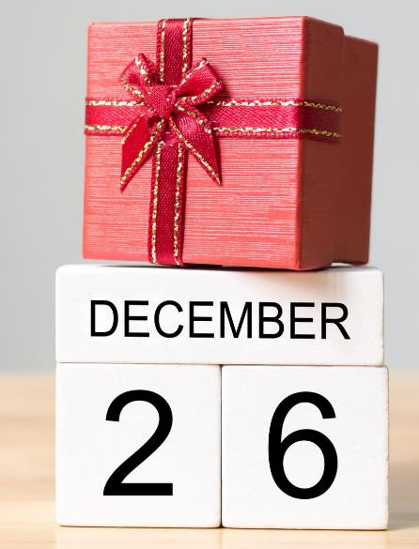
Why is boxing day called boxing day?
Lots of boxing matches take place
The rich used to box up gifts to give to the poor
You have to recycle all your boxes on this day
All boxes of chocolates have to be finished

Slide 31
Every year a particular country gives London a Christmas tree. Which country is it?
Norway
Germany
Papua New Guinea
Iceland

Slide 32
On the first day of Christmas,
My true love sent to me,
A ….. in a pear tree
A) Plum Pudding
B) Christmas Cracker
C) Blackbird
D) Partridge

Slide 33
Which of the following is not one of Father Christmas’ reindeer?
Dasher
Blitzen
Venus
Comet

Slide 34
In what film is 8 year old Kevin accidently left behind when his family go on holiday?
Home Alone
Elf
Sant Claus The Movie
It’s A Wonderful Life

Slide 35
What word meaning ‘Special, enjoyable events’ is also a tub of chocolates?
Parties
Celebrations
Festivities
Jubilees

Slide 36
Why is boxing day called boxing day?
Lots of boxing matches take place
The rich used to box up gifts to give to the poor
You have to recycle all your boxes on this day
All boxes of chocolates have to be finished

Slide 37
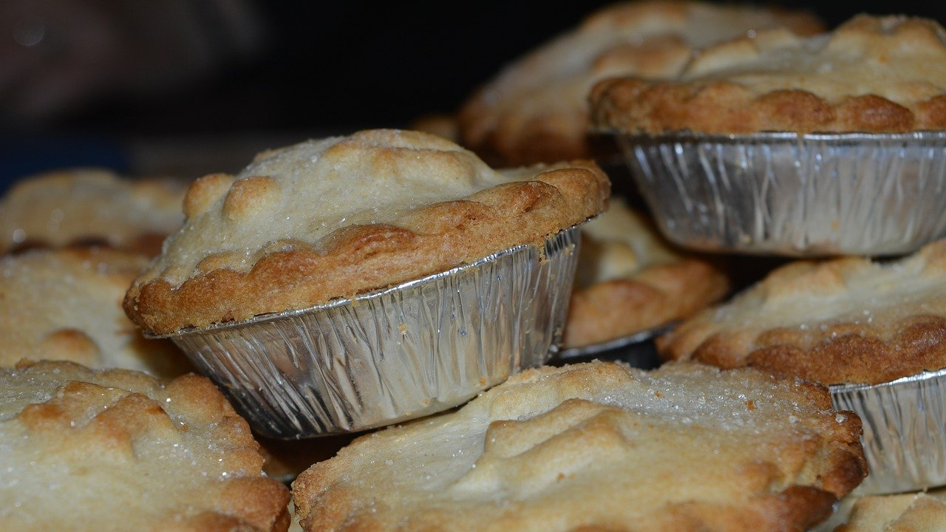
Round 4 – Festive Food

Slide 38
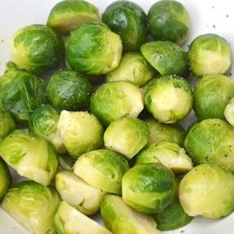
What festive food am I??? Part 1
I'm eaten during the main course on Christmas day (4 marks)
I'm full of vitamins that keep you healthy (3 marks)
My name also has links to a town in Belgium (2 marks)
I'm green, and lots of children don't like eating me :-( (1 mark)

Slide 39
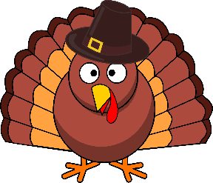
What festive food am I??? Part 2
King Henry VIII was the first monarch to eat me on Christmas day (4 marks)
I take a long time to cook (3 marks)
There is a wishbone inside me (2 marks)
10 million of me are eaten each Christmas in the UK (1 mark)

Slide 40
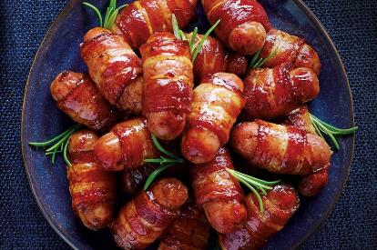
What festive food am I??? Part 3
A Scottish name for me is kilted soldiers (4 marks)
I am a porcine treat served with turkey (3 marks)
Vegetarians would not eat me (2 marks)
My name is not "Chickens in Scarves" (1 mark)

Slide 41
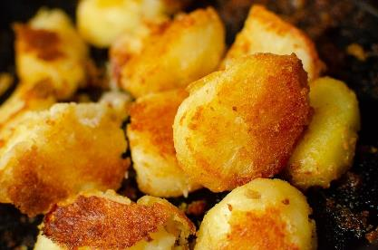
What festive food am I??? Part 4
I can be cooked in goose fat (4 marks)
I should be crunchy on the outside and fluffy in the middle (3 marks)
I go well with gravy (2 marks)
I am made from something you make crisps with (1 mark)

Slide 42
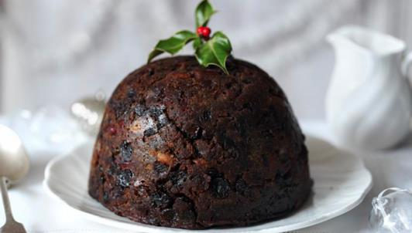
What festive food am I??? Part 5
I should be made 4-5 weeks before Christmas (4 marks)
Another name for me is plum pudding (3 marks)
Some people set me on fire! (2 marks)
I go very well with custard or cream... (1 mark)

Slide 43
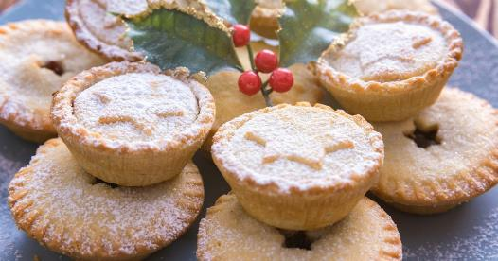
What festive food am I??? Part 6
I'm Cockney rhyming slang for eyes (4 marks)
I do not contain meat (3 marks)
Father Christmas often eats me on Christmas Eve (2 marks)
I have pastry on the outside (1 mark)

Slide 44
Round 5 – Mystery Objects

Slide 45
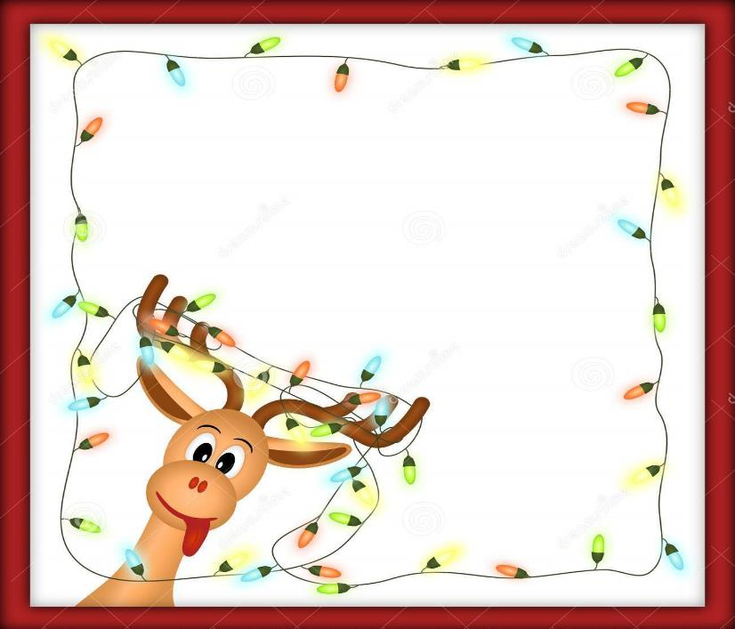
Can you guess what these old fashioned objects were used for?

Slide 46
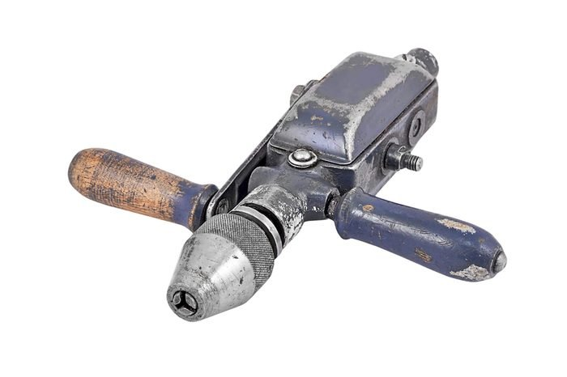
1

Slide 47
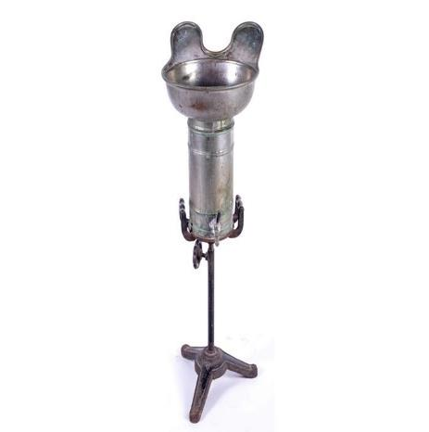
2

Slide 48
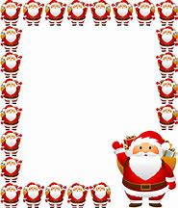
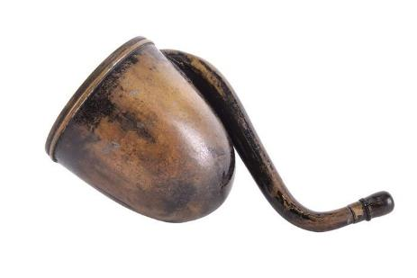
3

Slide 49
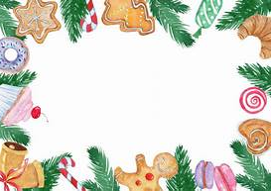
4

Slide 50
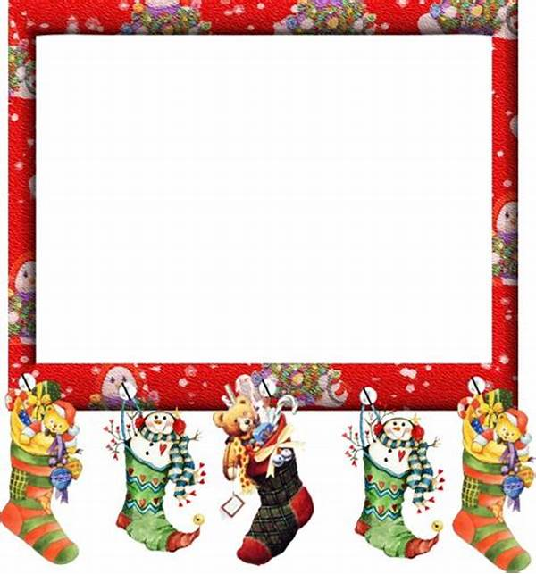
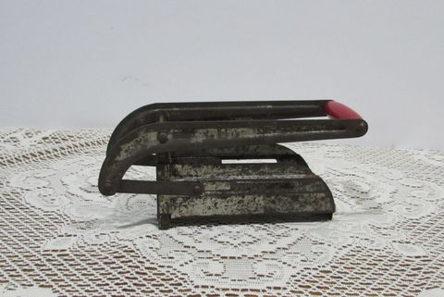
5

Slide 51
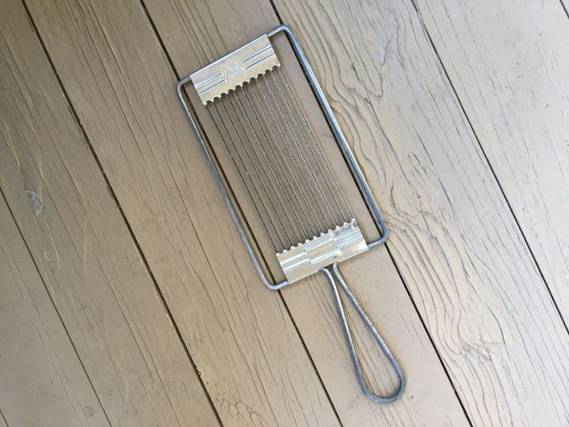
6

Slide 52
Lets see how many you got right

Slide 53
1
What did you guess?
A Drill

Slide 54
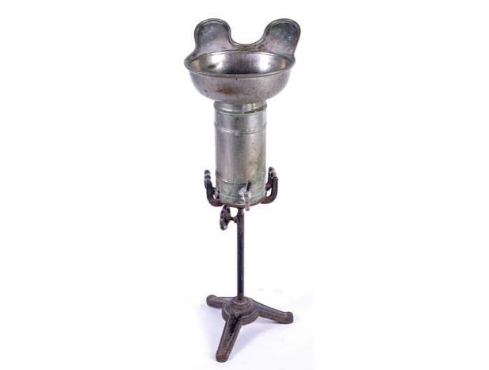
2
Hairdresser’s sink

Slide 55
3
Ear trumpet

Slide 56
Egg Opener
4

Slide 57
5
Chip slicer

Slide 58
6
Egg slicer

Slide 59
Count up your score!

Slide 60
Round 6 – Name That Tune!

Slide 61
NAME
THAT
TUNE!
Song Number 1
☑ Silent Night

Slide 62
3
2
NAME
THAT
TUNE!
Song Number 2
1
☑ Frosty the Snowman

Slide 63
NAME
THAT
TUNE!
Song Number 3
☑ Jingle Bells

Slide 64
NAME
THAT
TUNE!
Song Number 4
☑ Merry Christmas Everybody (Slade)

Slide 65
NAME
THAT
TUNE!
Song Number 5
☑ We Wish You a Merry Christmas

Slide 66
NAME
THAT
TUNE!
Song Number 6
☑ I Wish It Could Be Christmas Everyday (Wizzard)

Slide 67
The End!
Wishing you all a
MERRY CHRISTMAS
and a Happy New Year

